Slide 1

Summer of Code
Artificial Intelligence
(Machine Learning & Deep Learning)
Instructor
Wajahat Ullah
- Research Assistant (DIP Lab)
Duration
03 Months
(September – November)

Slide 2
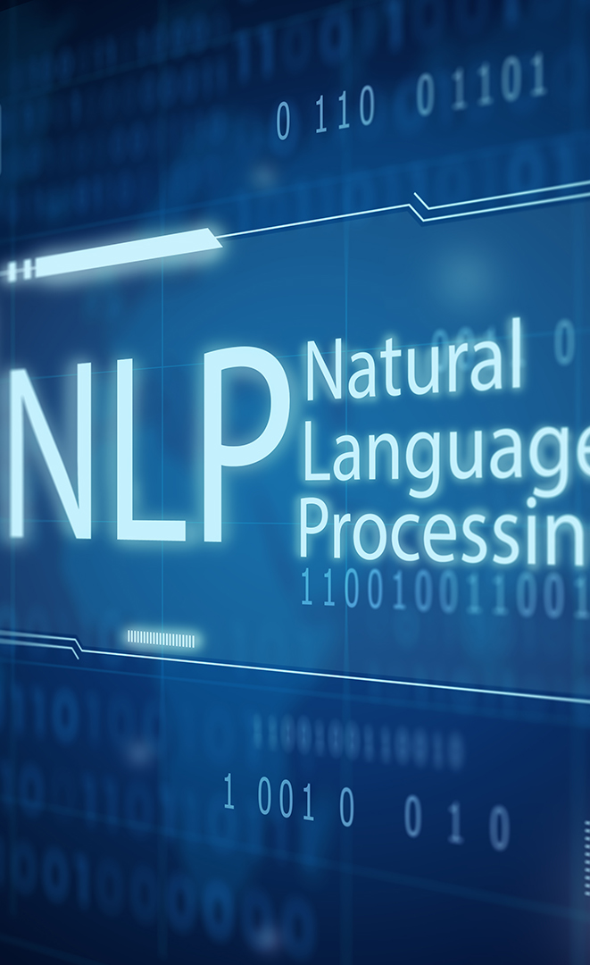
Day 03 – Deep Learning
(Natural Language Processing)
Objectives:
Natural Language Processing
Syntax, Semantics, Pragmatics, Discourse
Data Preprocessing

Slide 3
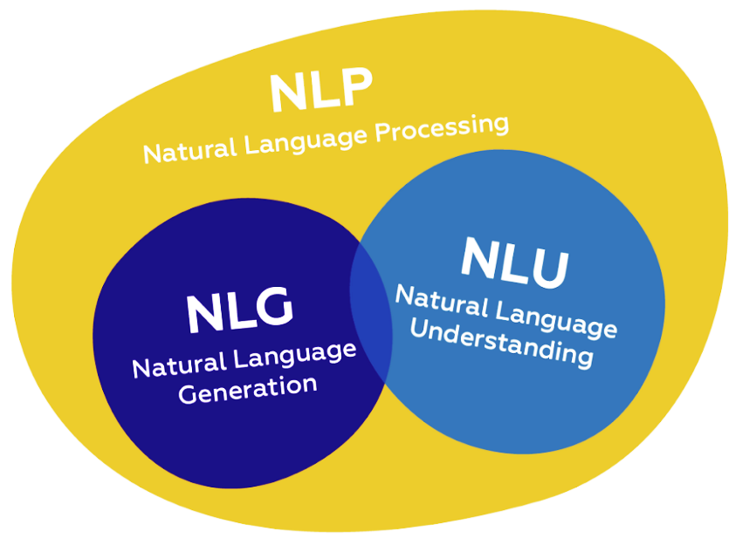

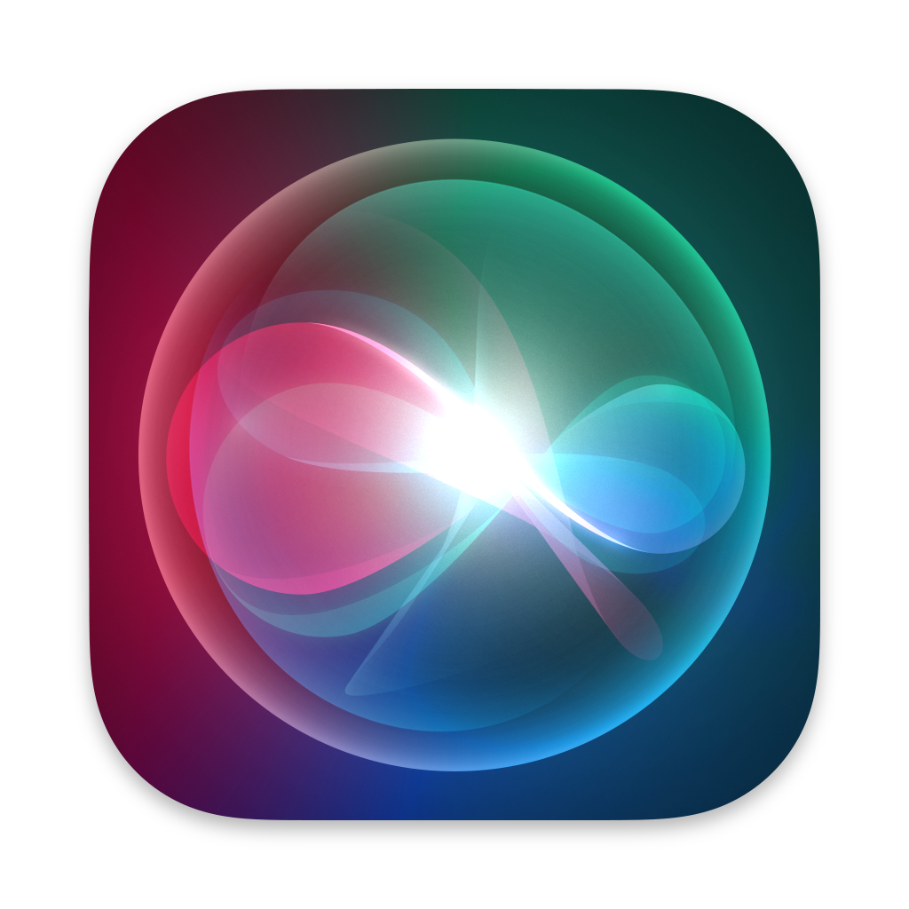

Natural Language Processing (NLP)
NLP is the discipline of building machines that can manipulate human language in the way that it is written, spoken, and organized
NLP can be divided into two overlapping subfields:
  Natural Language Understanding (NLU)
  Natural Language Generation (NLG)
It is separate from speech recognition.
It is integral part of everyday life.
ChatGPT
Siri
Gemini
Notes:
- Scientific computing involves using computational methods to solve complex scientific and mathematical problems.
Numeric (1995):
First version was called "Numeric" or "Numerical Python"
Created by Jim Hugunin at MIT
Evolution to NumPy (2006):
Travis Oliphant led the creation of NumPy

Slide 4
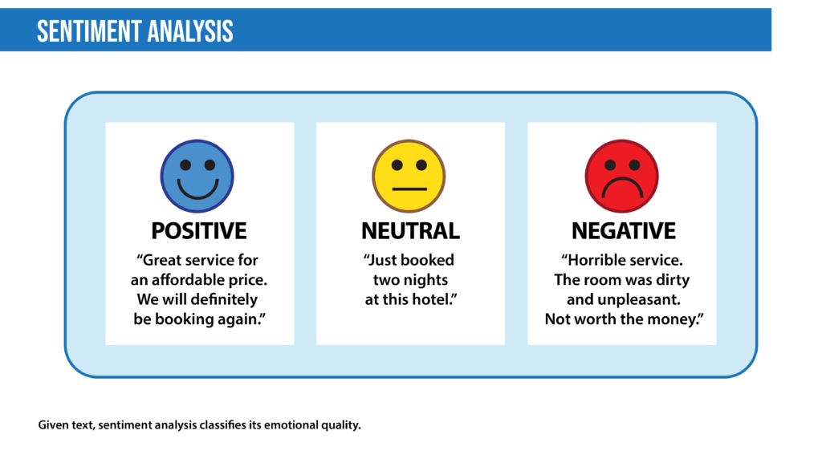
Applications of NLP
NLP is used for a wide variety of language-related tasks
Notes:
- Scientific computing involves using computational methods to solve complex scientific and mathematical problems.
Numeric (1995):
First version was called "Numeric" or "Numerical Python"
Created by Jim Hugunin at MIT
Evolution to NumPy (2006):
Travis Oliphant led the creation of NumPy

Slide 5
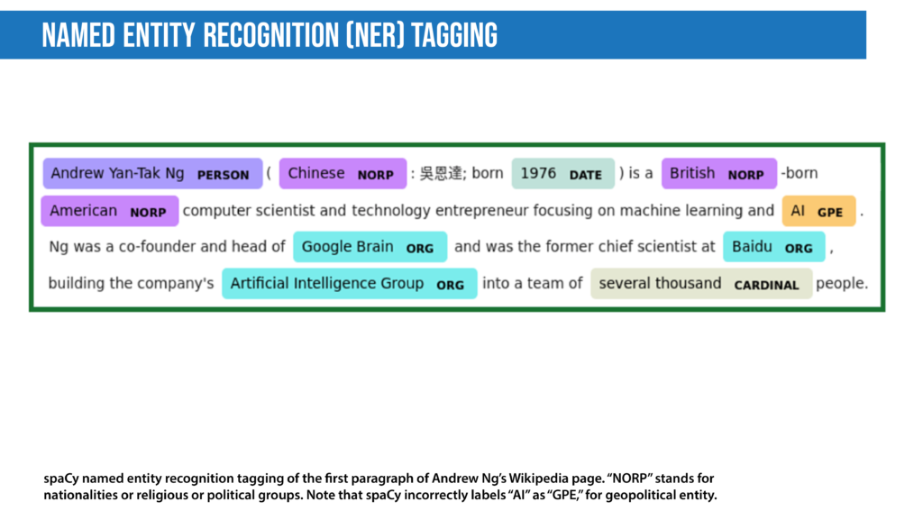
Applications of NLP
NLP is used for a wide variety of language-related tasks
Notes:
- Scientific computing involves using computational methods to solve complex scientific and mathematical problems.
Numeric (1995):
First version was called "Numeric" or "Numerical Python"
Created by Jim Hugunin at MIT
Evolution to NumPy (2006):
Travis Oliphant led the creation of NumPy

Slide 6
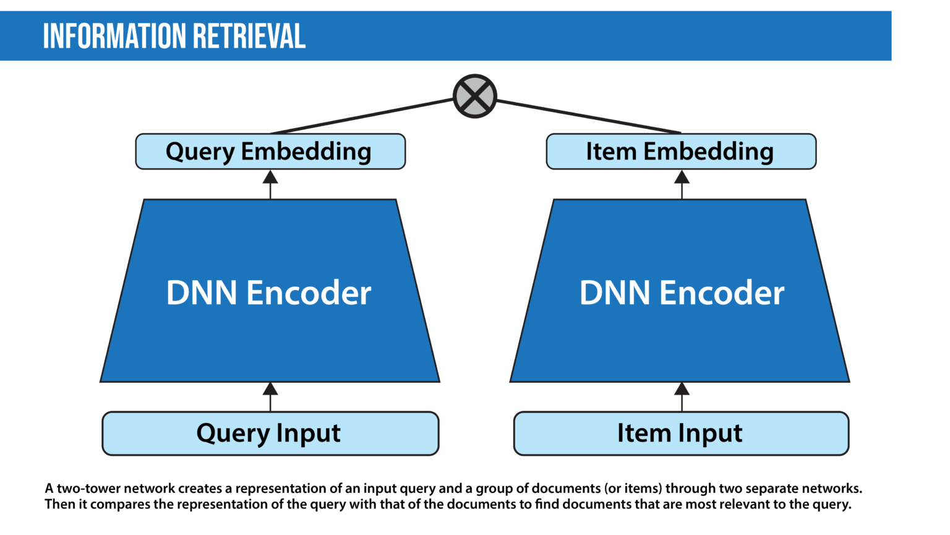
Applications of NLP
NLP is used for a wide variety of language-related tasks
Notes:
- Scientific computing involves using computational methods to solve complex scientific and mathematical problems.
Numeric (1995):
First version was called "Numeric" or "Numerical Python"
Created by Jim Hugunin at MIT
Evolution to NumPy (2006):
Travis Oliphant led the creation of NumPy

Slide 7

Applications of NLP
NLP is used for a wide variety of language-related tasks
Machine Translation
Notes:
- Scientific computing involves using computational methods to solve complex scientific and mathematical problems.
Numeric (1995):
First version was called "Numeric" or "Numerical Python"
Created by Jim Hugunin at MIT
Evolution to NumPy (2006):
Travis Oliphant led the creation of NumPy

Slide 8
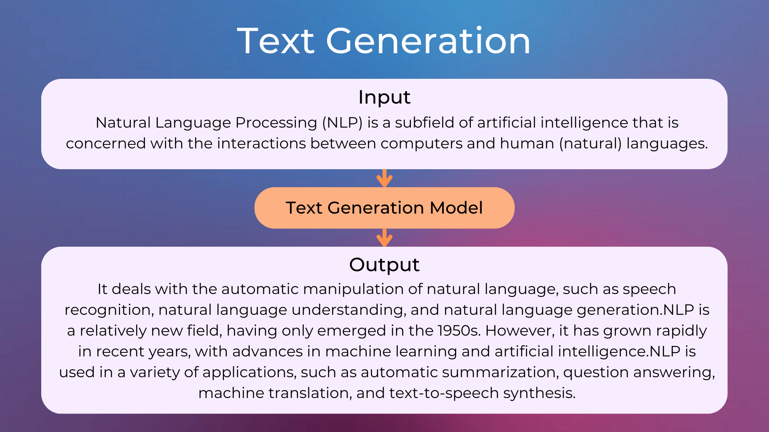
Applications of NLP
NLP is used for a wide variety of language-related tasks
Notes:
- Scientific computing involves using computational methods to solve complex scientific and mathematical problems.
Numeric (1995):
First version was called "Numeric" or "Numerical Python"
Created by Jim Hugunin at MIT
Evolution to NumPy (2006):
Travis Oliphant led the creation of NumPy

Slide 9
Understanding Language
Syntax (Structure)
Rules that governs the structure of sentences (Grammar).
It's about whether a sentence is correctly formed.
NLP Task: Parsing (creating a parse tree to understand sentence structure).
Semantics (Meaning)
Meaning derived from words, phrases, and sentences.
What does this word or sentence mean?
NLP Task: Word Sense Disambiguation.
Semantics (Meaning)
Syntax (Structure)
Raw Words
Notes:
- Scientific computing involves using computational methods to solve complex scientific and mathematical problems.
Numeric (1995):
First version was called "Numeric" or "Numerical Python"
Created by Jim Hugunin at MIT
Evolution to NumPy (2006):
Travis Oliphant led the creation of NumPy

Slide 10
Understanding Language
Pragmatics (Context)
How context contributes to meaning. It goes beyond the literal meaning to understand intent and implied meaning.
The meaning depends on the situation, the speaker, and the listener.
Discourse
Study of language beyond the single sentence. It looks at how sentences connect to form a coherent, meaningful whole.
Discourse
Pragmatics
Semantics (Meaning)
Syntax (Structure)
Raw Words
Notes:
- Scientific computing involves using computational methods to solve complex scientific and mathematical problems.
Numeric (1995):
First version was called "Numeric" or "Numerical Python"
Created by Jim Hugunin at MIT
Evolution to NumPy (2006):
Travis Oliphant led the creation of NumPy

Slide 11
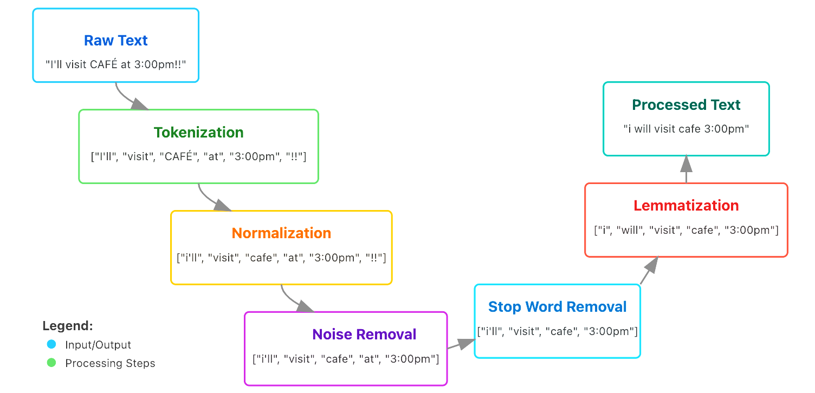
How NLP Works?
Data Preprocessing
Raw Text is Messy! It's full of noise (punctuation, HTML tags), variations, and extremely common words that add little meaning
Notes:
- Scientific computing involves using computational methods to solve complex scientific and mathematical problems.
Numeric (1995):
First version was called "Numeric" or "Numerical Python"
Created by Jim Hugunin at MIT
Evolution to NumPy (2006):
Travis Oliphant led the creation of NumPy

Slide 12
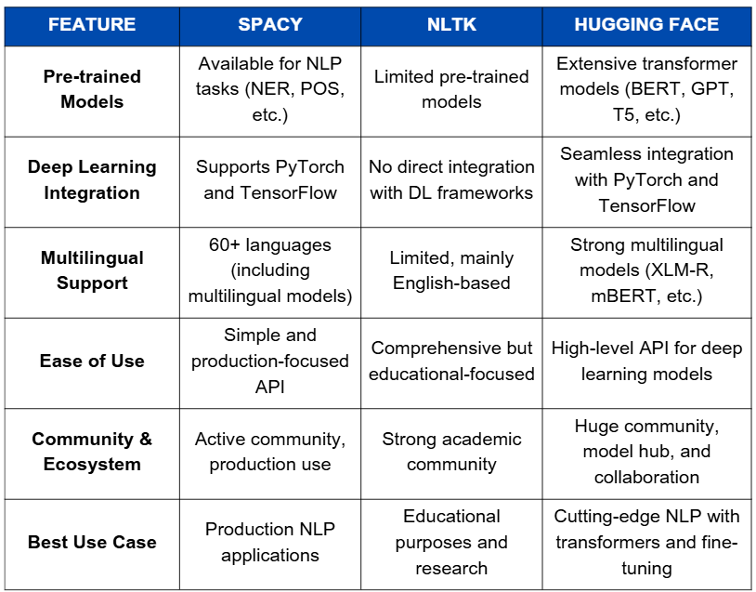
NLTK vs spaCy
Natural Language Toolkit
Great for teaching, research, and trying out many algorithms. It's a toolkit.
spaCy
Designed for real-world applications. It's fast, efficient, and provides a consistent API for a full pipeline.
Notes:
- Scientific computing involves using computational methods to solve complex scientific and mathematical problems.
Numeric (1995):
First version was called "Numeric" or "Numerical Python"
Created by Jim Hugunin at MIT
Evolution to NumPy (2006):
Travis Oliphant led the creation of NumPy

Slide 13

Thank You

